Slide 1
CRYPTOGRAPHY AND NETWORK SECURITY
DES

Slide 2
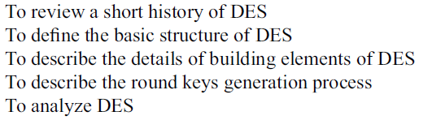
OBJECTIVES

Slide 3
DEFINATION
The Data Encryption Standard (DES) is a symmetric-key block cipher published by the National
Institute of Standards and Technology (NIST).

Slide 4
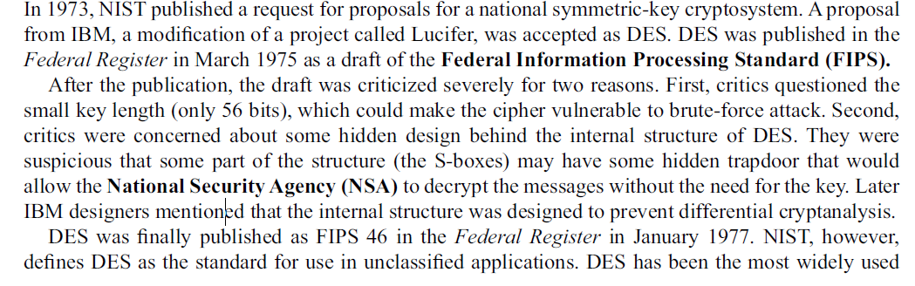
HISTORY

Slide 5
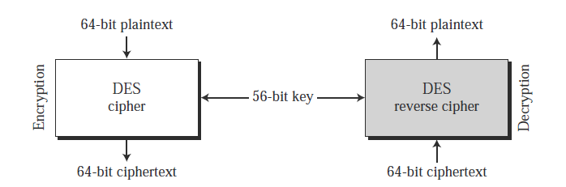
ENCRYPTION AND DECRYPTION

Slide 6
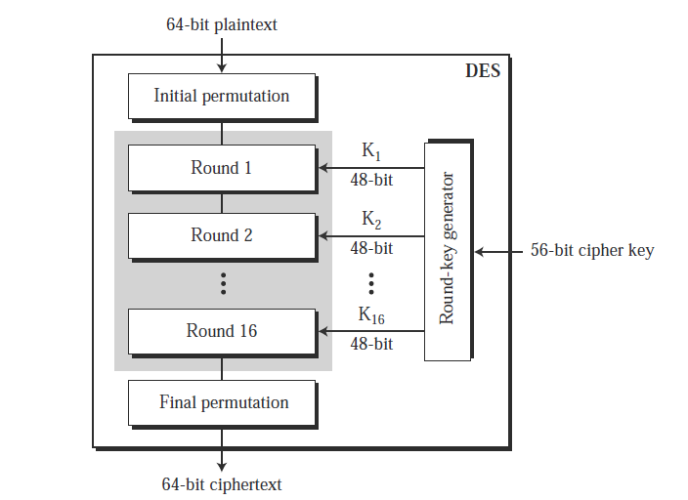
ROUNDS OF DES

Slide 7
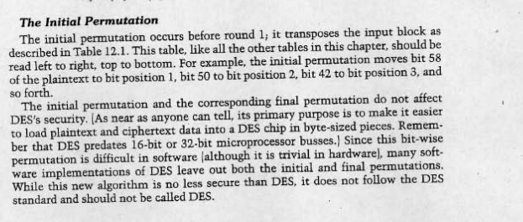
INITIAL PERMUTATION

Slide 8
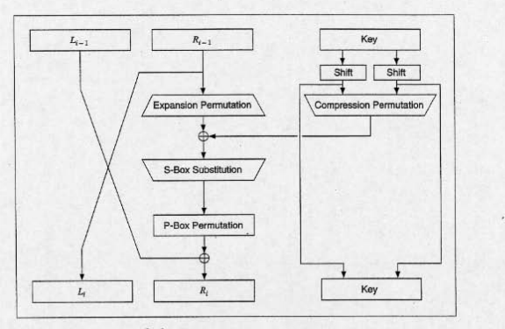
ONE ROUND OF DES

Slide 9
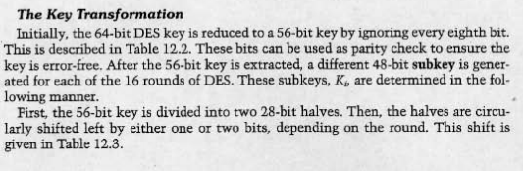

Slide 10


Slide 11
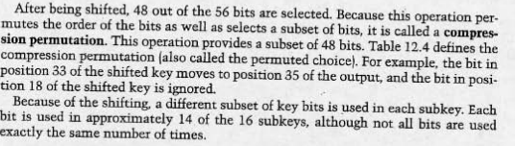
CONTINUED…

Slide 12
WEAKNESS IN DES
PRONE TO BRUTE FORCE ATTACK
KEY LENGTH WEAKNESS
Therefore TRIPLE DES IS INTRODUCED

Slide 13
References
“Cryptography and Network Security” by William Stallings.
Wade Trappe, Lawrence C Washington, “ Introduction to Cryptography with coding theory”, 2nd ed, Pearson, 2007.
W. Mao, “Modern Cryptography – Theory and Practice”, Pearson Education
Charles P. Pfleeger, Shari Lawrence Pfleeger – Security in computing Third Edition – Prentice Hall of India

